Slide 1

HEALTH PARTNER APP
Best of Care, In your Pocket

Slide 2

Supervisor: Mr. Junaid Malik
Group Members
Usman Ali
Haisam Rasool
Salman Shabbir
Maryam Amanat
12105119
12105067
12105021
12105014

Slide 3

Introduction
Health Partner app will help to modernized the health care sector. This app will be a mediator between patient, doctor and pharmacist. It will help the people in finding a nearby doctor or a pharmacy using mobile phone. It will have an appointment system so that people can have an appointment with any doctor using an app. It will also helps the doctors to keep record of patient’s history in centralized database so patient don’t have to carry files. Our app will also have a feedback system to rate doctor.

Slide 4
Objective
Provide the facility to the common person having smartphone to look up a qualified doctor, specifically for his disease or get the medicines from the pharmacy without going any where.
Appointment with a doctor and getting medicines will be just a click away from you. No need to wait in queue for hours for checkup.

Slide 5
Problem Description
The existing system is manual and people are waiting for their turn. Some people after waiting for hours get the words that “the remaining people will be treated tomorrow”.
In most cases doctor wants to see your medical history to diagnosis and prescribe medicine accordingly.
Disabled people are unable to go to the pharmacy and buy medicines. They always need someone to get them some medicines.
Most peoples moving to other cities don’t knows the location nearby hospitals or pharmacy.

Slide 6
Solution
We are making an application which will help people in finding a specialized doctor closest to their current/specified location.
Any person can register into our system as a general user using CNIC.
User can make an appointment with doctor if doctor is available.
No need to make files and take with you every time you visit a doctor. As all your history is maintained on online central DB.
Doctors will be able to add their clinics.
Doctor will be to add his/her availability time.

Slide 7
Solution
Doctors will be able to create and maintain the history of his patients. (History: current recent conditions and prescription)
User will be able to order medicines for home delivery using prescription from the app.
This app will also help people in finding a nearby pharmacy or hospital based on their current/ specified location.
This app will also give them directions from their current/ specified location to a doctor or pharmacy.
After getting treatment a patient can rate his/her doctor.

Slide 8
Background and Defense
There is very little work has been done in this field.
Like there are very few app that are available in Pakistan
like
Marham
PakWebMD
FindMyDoctor
RingMD

Slide 9

Background and Defense
Among all these app only Marham and PakWebMD did mentionable work.
PakWebMD is only for Islamabad. It will only help you in finding a doctor.
Marham is current available for multiple cities and they’re expanding and just like all other apps this also help only in finding a doctor.
This app will tell you the address of the doctor and for an appointment it just gives you a number to call.

Slide 10
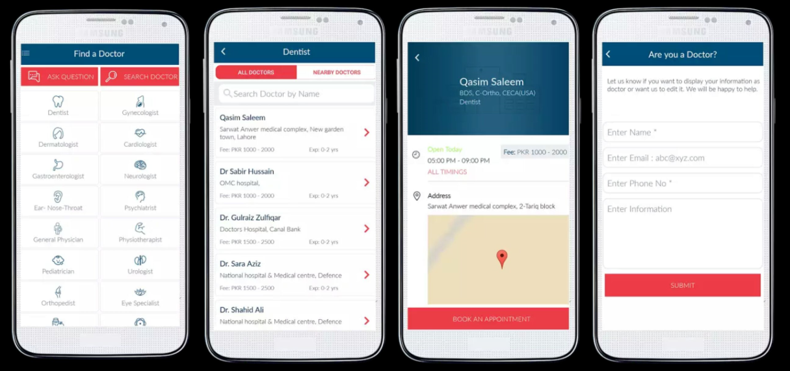
Background and Defense

Slide 11
Scope
We are handling
User, Doctor or clinic, and pharmacy registration.
User can search and get directions to the nearest clinic and pharmacy from current/ specified location.
User can get appointment from the doctor.
User can order home delivery of medicines.
Currently we are not handling emergency services like home treatment.

Slide 12
Functional Requirements
General User
FR-01 | User shall register him/herself using CNIC.
FR-02 | User shall add further details after confirmation from NADRA.
FR-03 | User shall register him/herself as doctor using PMDC license number.
FR-04 | User shall register him/herself as doctor using pharmacy license number.

Slide 13
Functional Requirements
Patients
FR-05 | Patient shall search a nearby doctor by using current location.
FR-06 | Patient shall search a nearby doctor by using specified location.
FR-07 | Patient shall search a nearby doctor by doctor’s specialty.
FR-08 | Patient shall view doctor profile.
FR-09 | Patient shall view doctor’s clinic on map.
FR-10 | Patient shall get the directions to doctor’s clinic from current location.
FR-11 | Patient shall schedule an appointment with doctor.

Slide 14
Functional Requirements
Patient(Continue)
FR-12 | Patient shall be able to view the scheduled appointments.
FR-13 | Patient shall be able to view personal history.
FR-14 | Patient shall be able to view prescriptions.
FR-15 | Patient shall search a nearby pharmacy to current location.
FR-16 | Patient shall order medicine using prescription from the application.

Slide 15
Functional Requirements
Doctors
FR-17 | Doctor shall add details of his/herself clinic after the verification from PMDC.
FR-18 | Doctor shall view his/her appointments with patients.
FR-19 | Doctor shall view the previous history (conditions) of a patient.
FR-20 | Doctor shall add the history (conditions) of a patient.
FR-21 | Doctor shall view the previous prescriptions of a patient.
FR-22 | Doctor shall add the prescription of a patient.

Slide 16
Functional Requirements
Pharmacist
FR-23 | Pharmacist shall register the pharmacy.
FR-24 | Pharmacist shall view the orders.
FR-25 | Pharmacist shall marked the delivered orders as delivered.

Slide 17
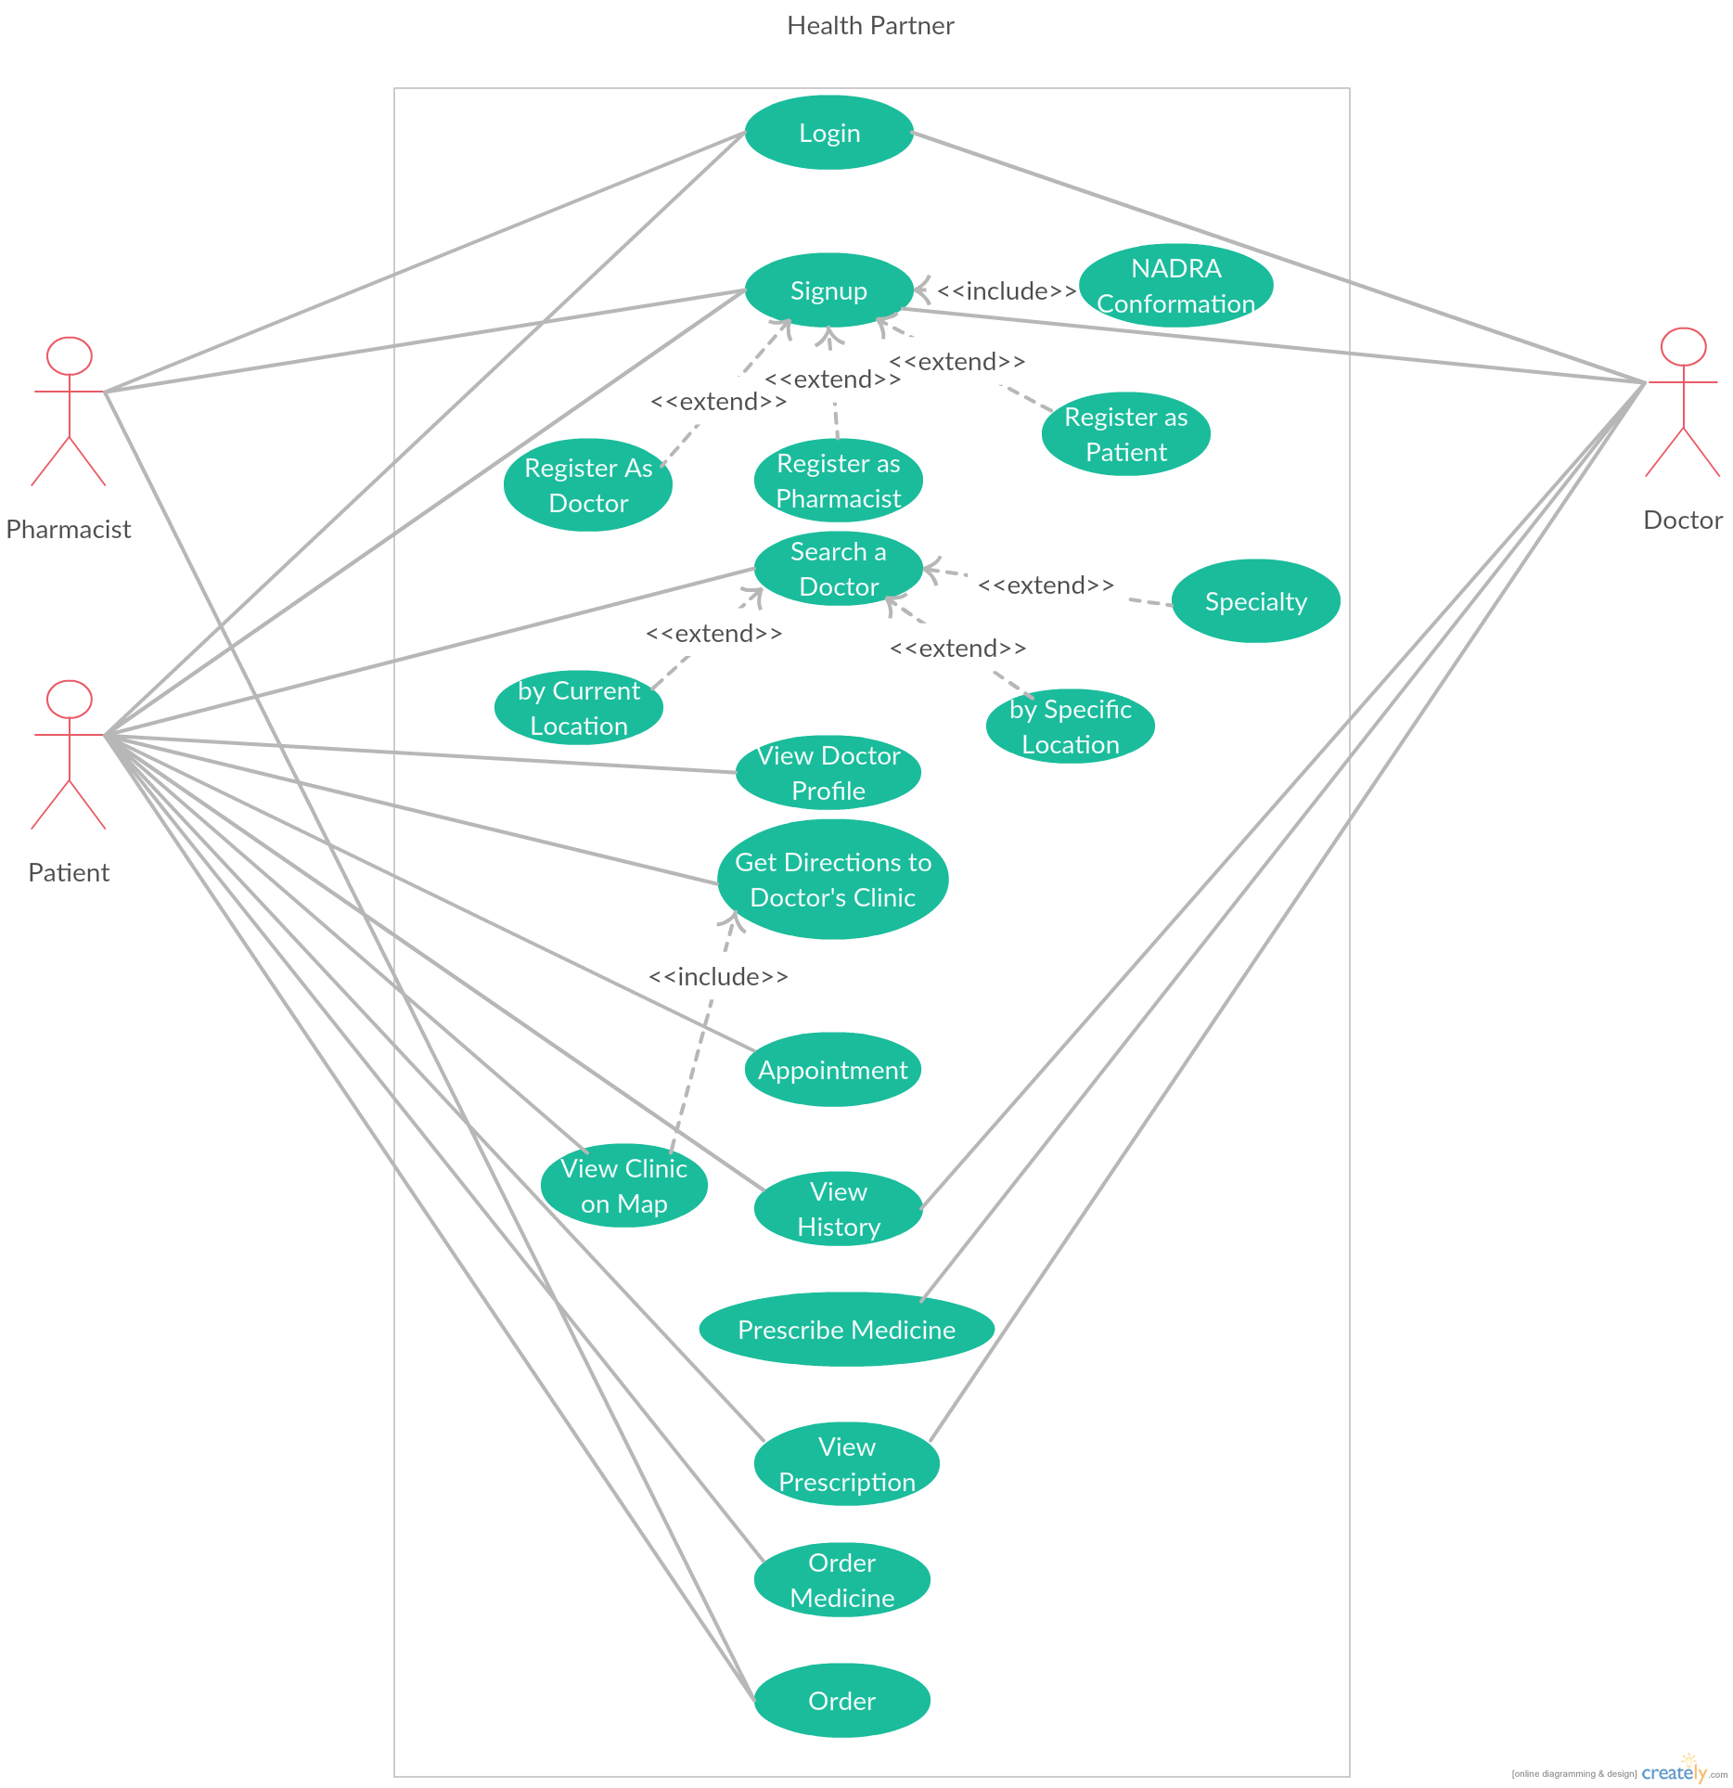

Slide 18
Tools/Technology
Android Studio(IDE)
Google Map API
SMS Service
XAMPP/Online Sever
XML, JAVA, JSON, PHP and MySQL

Slide 19

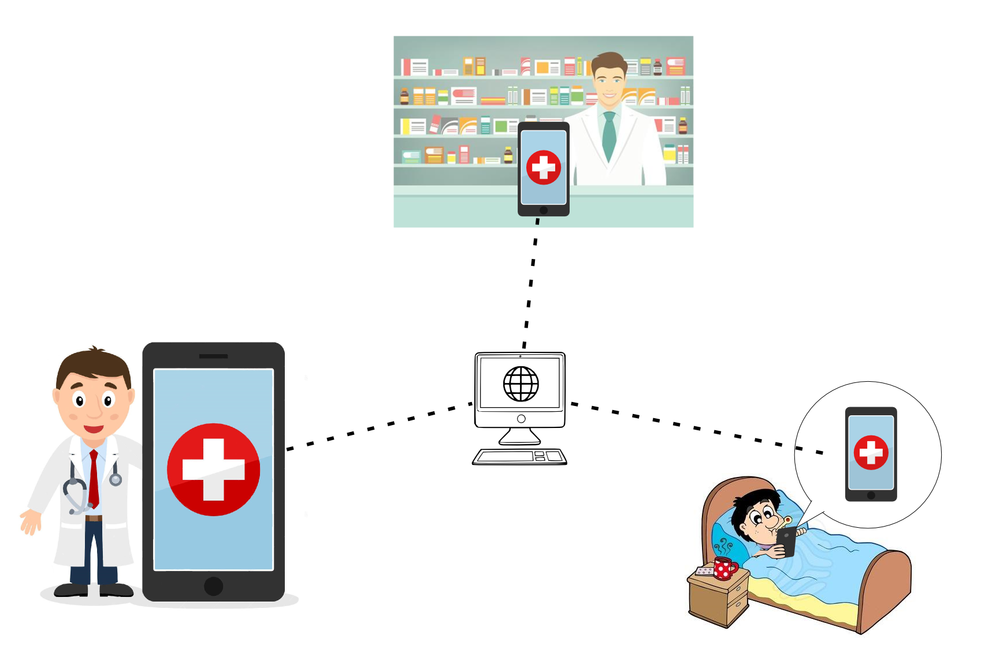
Demonstration

Slide 20
Questions?

Slide 21
Thanks!

